Slide 1
Role of Metadata
Prof. Navneet Goyal
Department of Computer Science & Information Systems
BITS, Pilani

Slide 2
Topics
Metadata
Metadata Components
Role in Data Warehousing

Slide 3
Metadata
The first image most people have of the data warehouse is a large collection of historical, integrated data.
While that image is correct in many regards, there is another very important element of the data warehouse that is vital – metadata
Metadata is data about data
Not a new concept – has been around as long as there have been programs and the data on which these programs operate

Slide 4
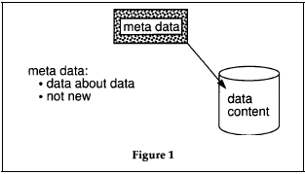
Metadata

Slide 5
Metadata
While metadata is not new, its role in DW is certainly new
Metadata has been continuously ignored in conventional IT systems
Ignoring it in a DW environment is to defeat the very purpose of a DW
Metadata assumes an important role in a DW
The importance of metadata in a DW could be attributed to its difference from operational systems

Slide 6
Metadata
The community served and the importance to that community are the primary reasons as to why metadata is so important in the DW environment
IT professional is the primary community involved in the operational development and maintenance
  Computer literate and is able to find its way around systems
DW serves the DSS analysts community
  Not necessarily computer literate and needs help in navigating the system

Slide 7
Metadata
Second reason – DSS analyst needs to know in order to do his/her job is what data is available and where it is in the data warehouse.
When the DSS analyst receives an assignment, the first thing the DSS analyst needs to know is what data there is that might be useful in fulfilling the assignment.
For this, the metadata for the warehouse is vital to the preparatory work done by the DSS analyst.
The information technology professional has been doing his/her job for many years while treating metadata passively.

Slide 8
Mapping
A basic part of the data warehouse environment is that of mapping from the operational environment into the data warehouse
  mapping from one attribute to another,
  conversions,
  changes in naming conventions,
  changes in physical characteristics of data,
  filtering of data, etc.

Slide 9
Mapping
Consider the vice president of marketing asked for a new report.
Upon inspection, the vice president proclaims the report to be fiction
The credibility of the DSS analyst who prepared the report goes down until he/she can prove the data in the report to be valid.
The DSS analyst first looks to the validity of the data in the warehouse. If the DW data has not been reported properly, then the reports are adjusted.
However, if the reports have been made properly from the DW, the DSS analyst is in the position of having to go back to the operational source to salvage credibility.
At this point, if the mapping data has been carefully stored, then the DSS analyst can quickly and gracefully go to the operational source
However, if the mapping has not been stored or has not been stored properly, then the DSS analyst has a difficult time defending his/her conclusions to management.
The metadata is a natural place for the storing of mapping information.

Slide 10
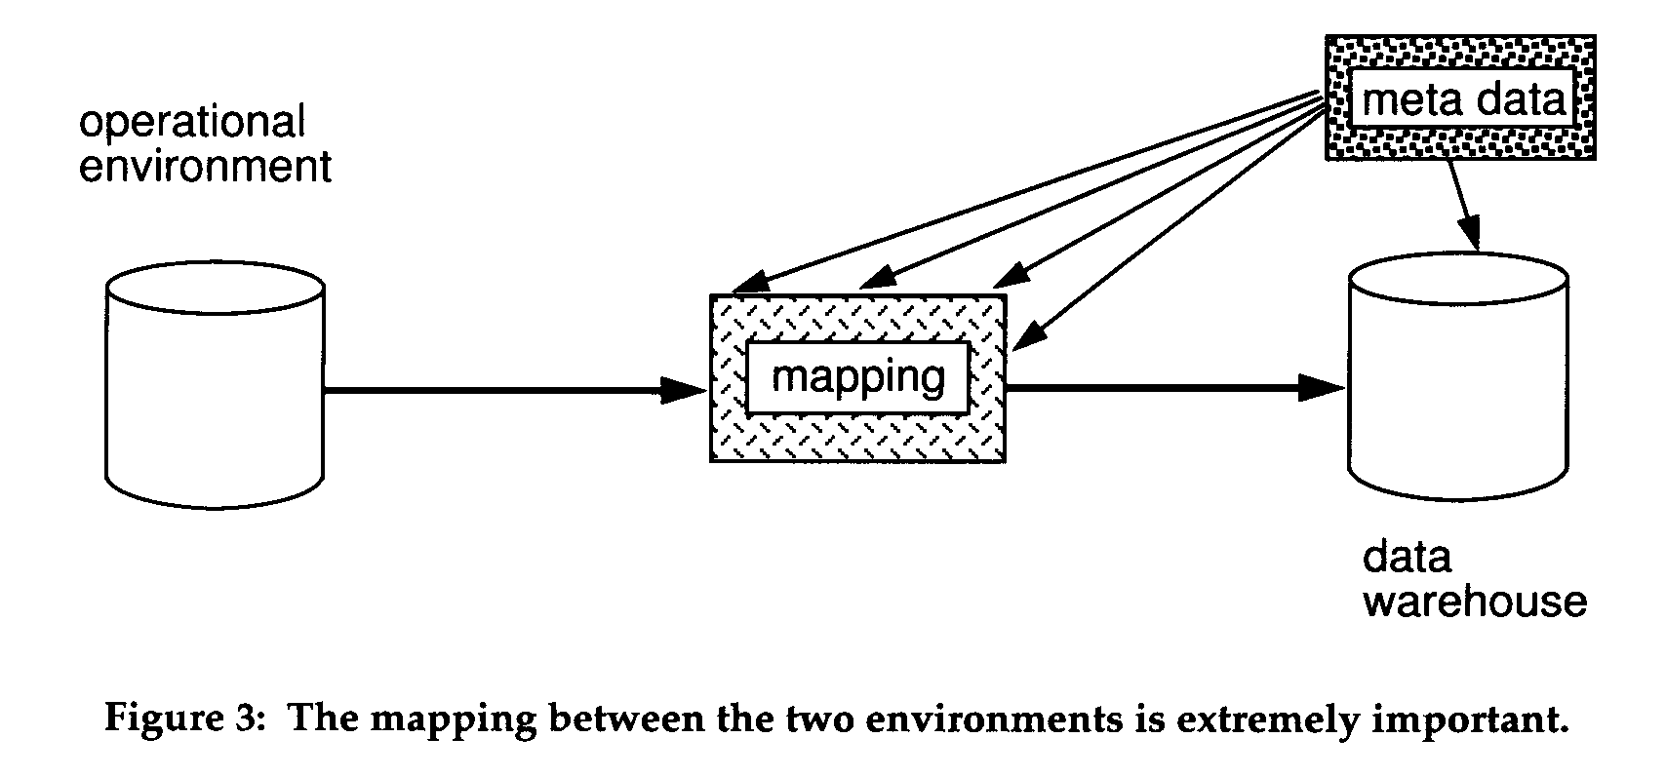
Mapping

Slide 11
Managing Data over Time
Another important function of the metadata is that of management of data over time
Time span of data in a DW is much longer than operational systems
5-10 year span is normal vs. few weeks to 3 months in operational systems
The storage of multiple data structures for the data warehouse is contrasted with the storage of a single data structure as found in the operational environment.
One of the fundamental concepts of data management in the operational environment is that there is one and only one correct definition of data

Slide 12
Managing Data over Time
This assumption is 180 degrees the opposite of the data found in the data warehouse.
Managing data over a long spectrum
of time then is another reason why metadata in the data warehouse is so important

Slide 13
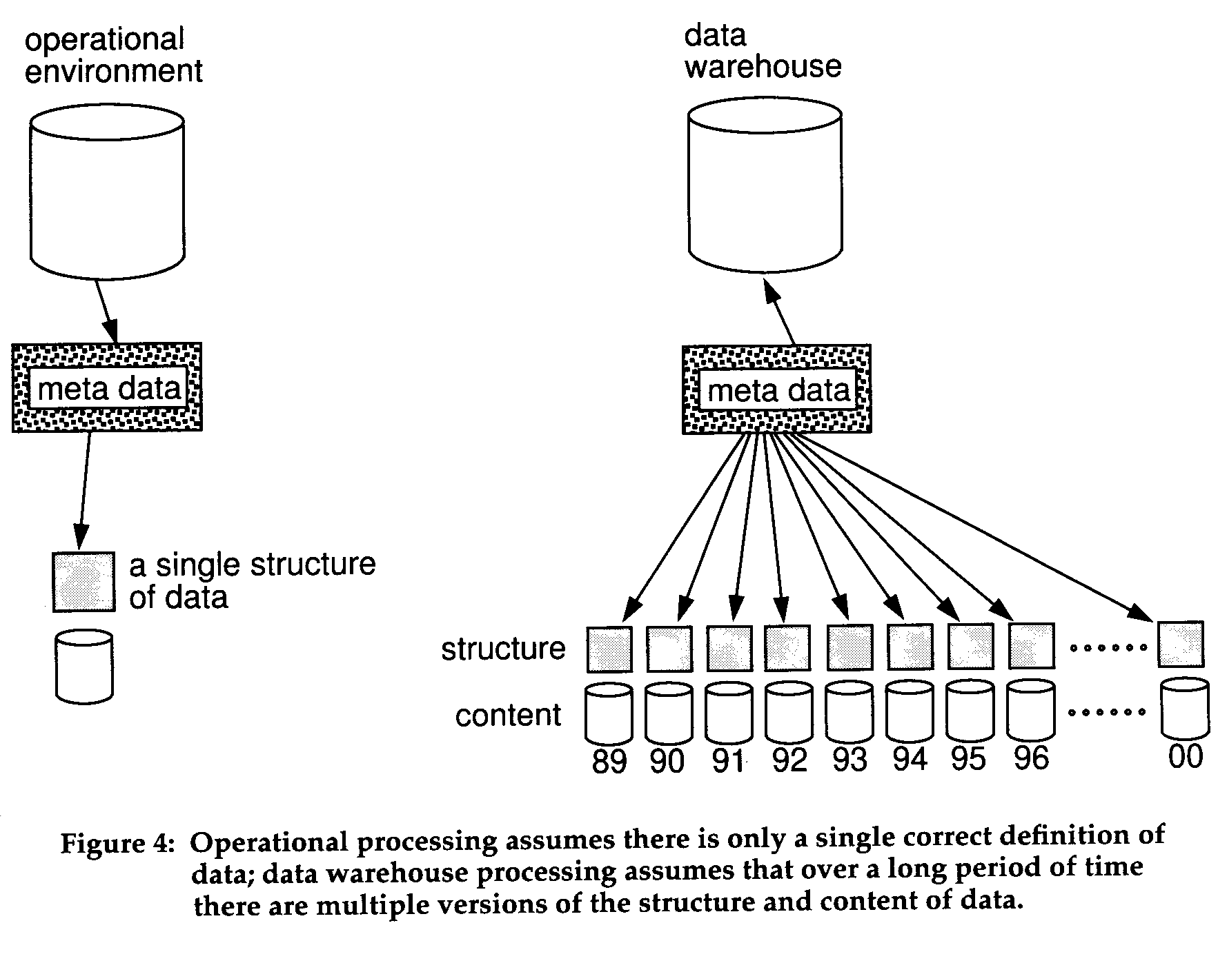
Managing Data over Time

Slide 14
Versioning of Data
Because data must be managed over a long spectrum of time in the DW environment (and correspondingly, the associated metadata must be likewise managed), metadata must be "versioned".
Versioned data is data that allows changes to be continuously tracked over a long period of time.

Slide 15
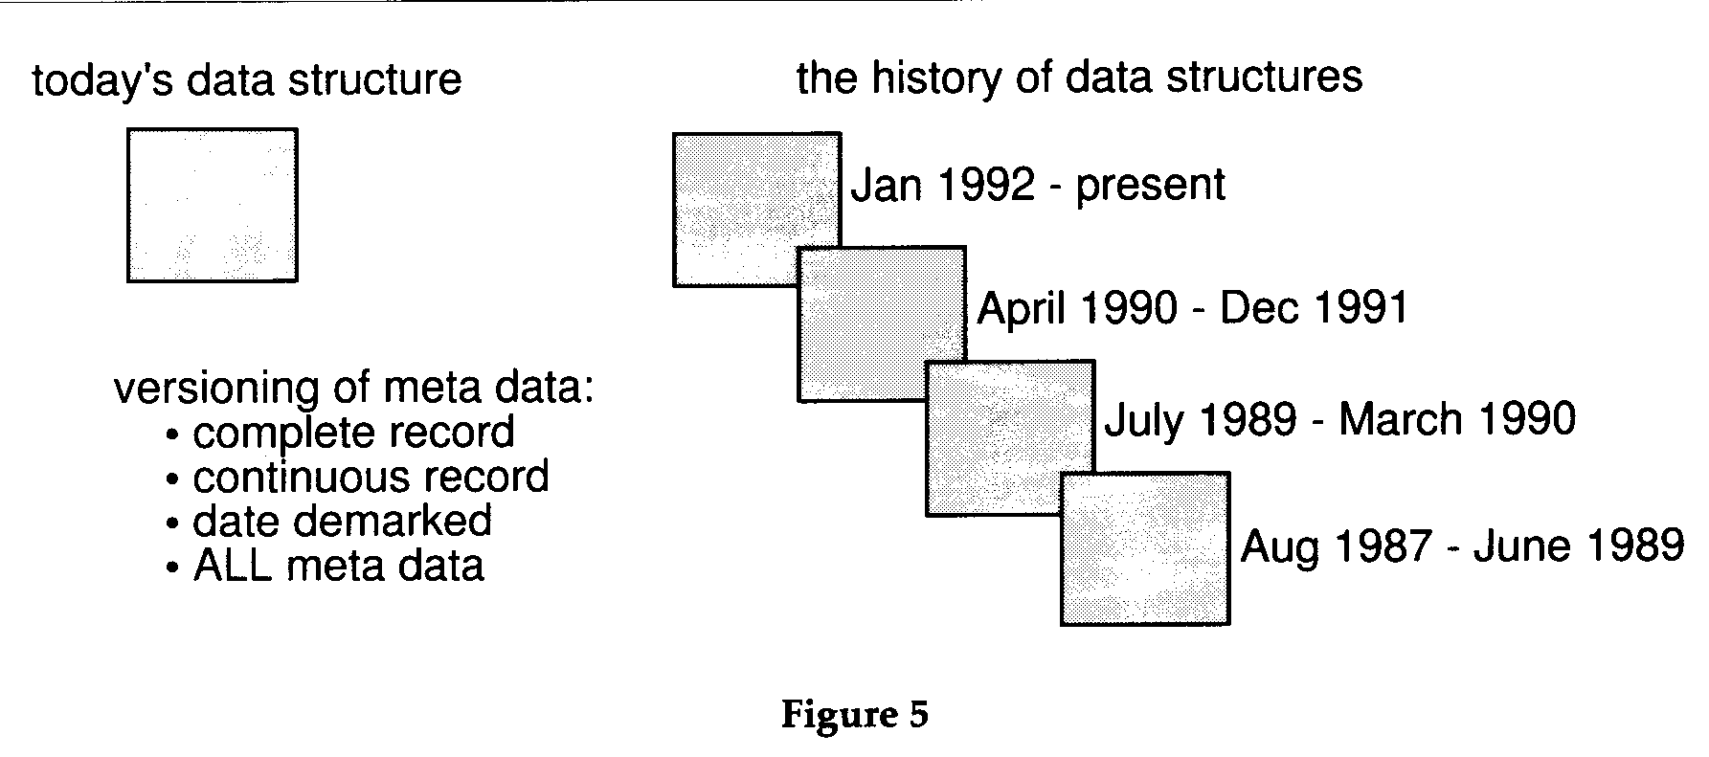
Versioning of Data

Slide 16
Versioning of Data
In Figure 5 it is seen that both the current status of a structure can be found AND the history of changes to that structure can likewise be found.
This tracking is a necessary feature for ALL types of metadata in the DW store of metadata.
One of the characteristics of versioning is that the data trail be continuous and non-overlapping.
In other words it is important that for any moment in the past there be one and only one value or status of metadata.
Effective from & Effective to dates on metadata component

Slide 17
Versioning of Data
When the DSS analyst wants to interrogate a calculation or report made in the past that the versioning allows the DSS analyst to understand what data was and where it came from as it entered the warehouse.
Without versioning, the only meaningful data a DW environment has is data written for and managed under the most current definition and structure of data.

Slide 18
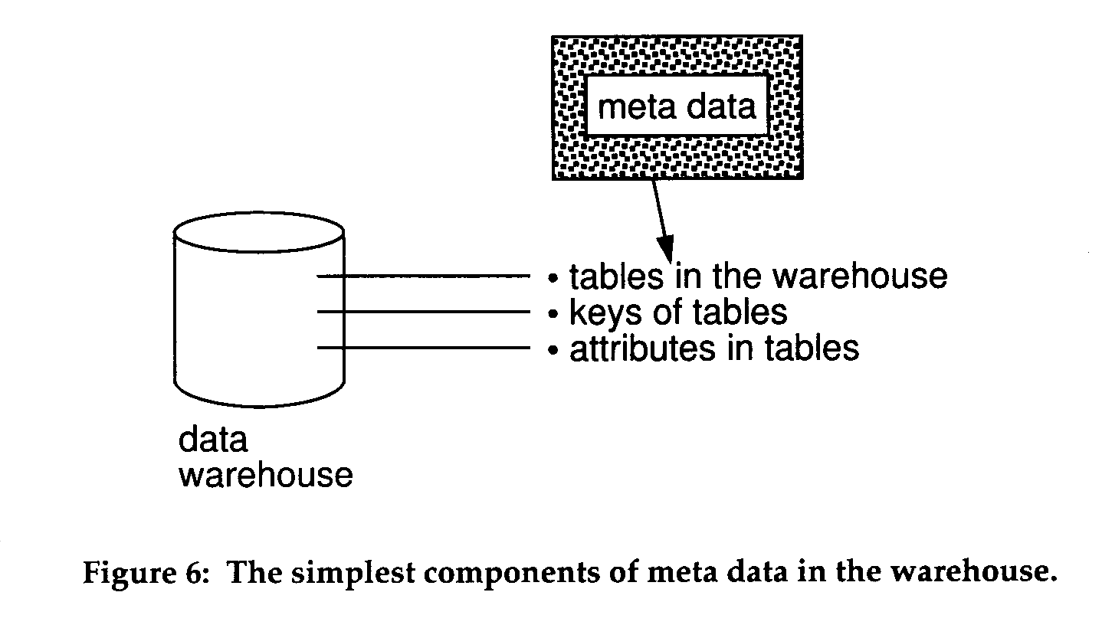
Metadata Components
Basic Components
The basic components of the DW metadata store include the tables that are contained in the warehouse, the keys of those tables, and the attributes

Slide 19
Metadata Components
Mapping
One of the most important components of DW metadata
  identification of source field(s),
  simple attribute to attribute mapping,
  attributes conversions,
  physical characteristic conversions,
  encoding/reference table conversions,
  naming changes,
  key changes,
  defaults,
  logic to choose from multiple sources,
  algorithmic changes, and so forth.
Like all other data warehouse metadata, these components should be versioned

Slide 20
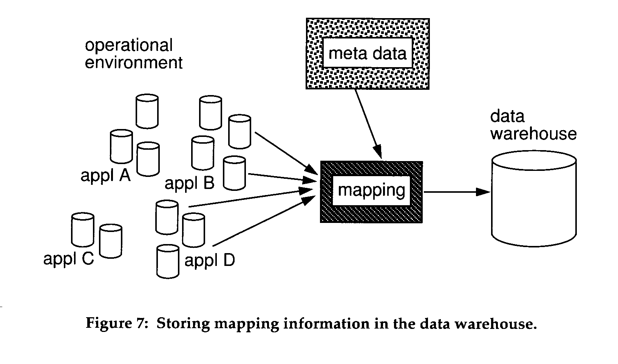
Metadata Components
Mapping

Slide 21
Metadata Components
Extract History
The actual history of extracts and transformations of data coming from the operational environment and heading for the DW is another component that belongs in the DW metadata store
It tells the DSS analyst when data entered the data warehouse
The DSS analyst has many uses for this type of information

Slide 22
Metadata Components
Extract History
when was the last time data in the warehouse was refreshed.
if processing and the assertions of analysis have changed.
whether the results obtained for one analysis are different from results obtained by an earlier analysis because of a change in the assertions or a change in the data

Slide 23
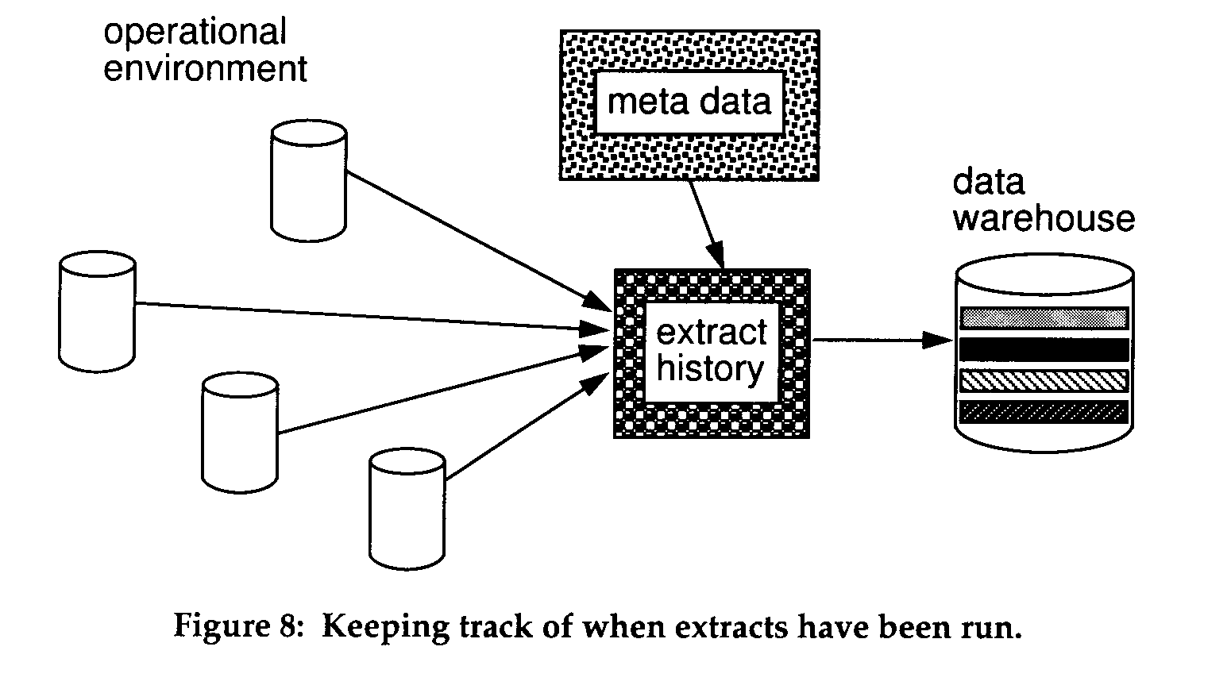
Metadata Components
Extract History

Slide 24
Metadata Components
Miscellaneous
Alias
Status
Volumetric
Aging/Purging criteria

Slide 25
Metadata Components
Miscellaneous
Alias – recall role playing dimensions
Status - In some cases a table is undergoing design. In other cases the table is inactive or may contain misleading data
Volumetric –
  the number of rows currently in the table,
  the growth rate of the table,
  the statistical profile of the table,
  the usage characteristics of the table,
  the indexing for the table and its structure,
Aging/Purging criteria - definition of the life cycle of data warehouse data

Slide 26
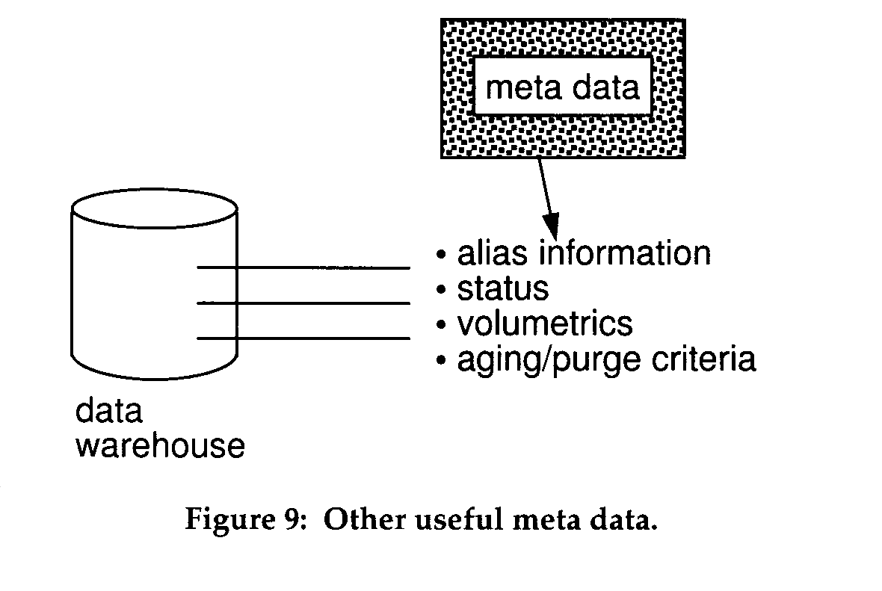
Metadata Components
Miscellaneous

Slide 27
Coming up next…
Types of Metadata

